Slide 1

Capstone Project-1
EDA of
Play Store App Review
BY
Anjali Tidke
Shubham Dukare

Slide 2
Introduction:
The Play Store apps data has enormous potential to drive app-making businesses to success.
Actionable insights can be drawn for developers to work on and capture the Android market.
Each app (row) has values for category, rating, size, and more. Another dataset contains customer reviews of the android apps.
Explore and analyze the data to discover key factors responsible for app engagement and success.

Slide 3
Steps involved in this project as follows.
Import the required libraries
Load the csv files from google drive
Basic data information
Cleaning the Data
Merging two dataset
Data Visualization
Conclusion

Slide 4
Import the required libraries
We are imported following libraries:
import numpy as np - NumPy is a general-purpose array-processing package. It provides a high-performance multidimensional array object, and tools for working with these arrays.
import pandas as pd - Pandas is usually imported under the pd alias. alias: In Python alias are an alternate name for referring to the same thing. Now the Pandas package can be referred to as pd instead of pandas
import matplotlib.pyplot as plt - matplotlib. pyplot is a collection of command style functions that make matplotlib work like MATLAB. Each pyplot function makes some change to a figure: e.g., creates a figure, creates a plotting area in a figure, plots some lines in a plotting area, decorates the plot with labels, etc.
import seaborn as snsv - The import seaborn portion of the code tells Python to bring the Seaborn library into your current environment. The as sns portion of the code then tells Python to give Seaborn the alias of sns. This allows you to use Seaborn functions by simply typing sns. function_name rather than seaborn.
import plotly.express as px- The plotly.express module (usually imported as px ) contains functions that can create entire figures at once, and is referred to as Plotly Express or PX.

Slide 5
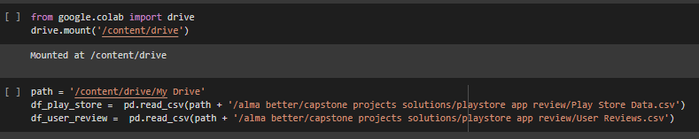
Load the csv files from google drive:
Here we are load the CSV files from google drive
They are given two dataset one is play store data review and second is user review dataset both we are imported and define as df_play_store & df_user_review

Slide 6
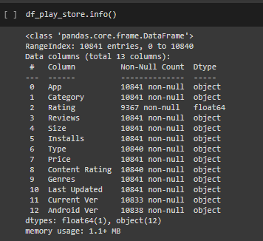
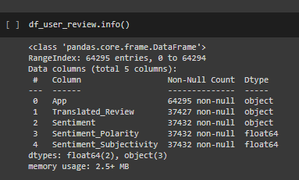
Basic data information
In play store data set total columns are 13
Datatypes are float64(1) and object(12)
In user review dataset total column are 5
Datatypes are float64(2) and object(3)

Slide 7
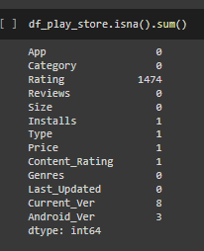
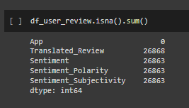
Cleaning the Data
Finding null value of Play store data set
Finding null value of User review data set

Slide 8
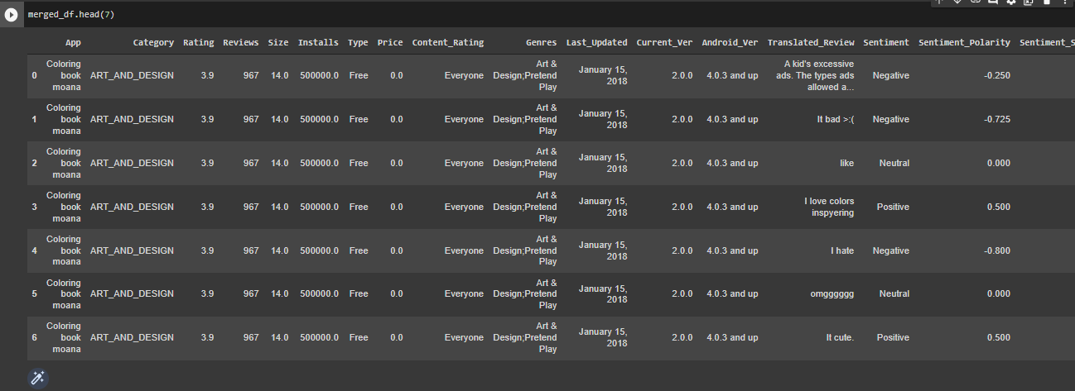
Merging two dataset
Here we are merged play store dataset and user review dataset

Slide 9
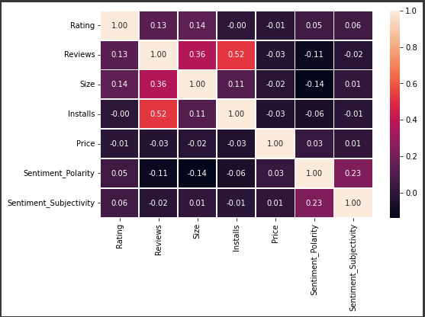
Data Visualization
Correlation map
Correlation Matrix using Heatmap we are used to find out correlated row & column
From this heatmap analysis we can see that Installs and Reviews are Positively Correlated.

Slide 10
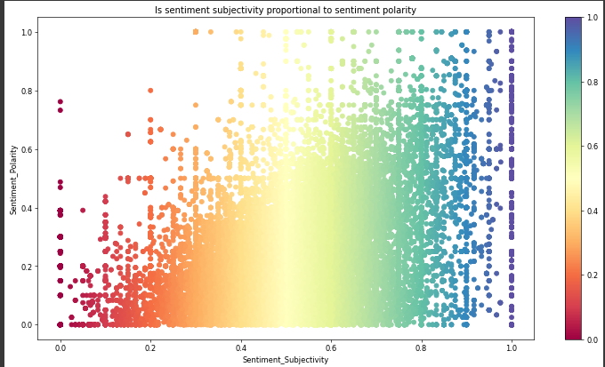
Sentiment subjectivity
we can see here scatter plot analysis sentiment subjectivity is not proportional to sentiment polarity but in many cases, we can see a proportional behavior when variance is very low or high.

Slide 11
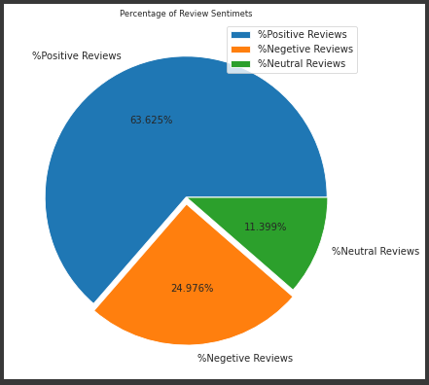
How sentiment is divided for different type of reviews by using pie chart.
Here we concluded as per pie chart it can be easily understood positive user review sentiments is 65%, negative user review sentiment is 22% and neutral user review sentiments is 11.399%

Slide 12
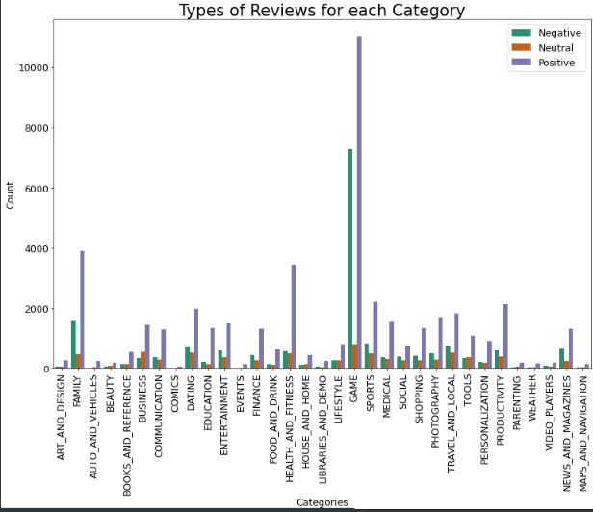
Type Vs review for each category
we can see from above chart, every category is having more Positive reviews than Negative and Neutral reviews
from above analysis we can see health and fitness having high no of positive reviews as compare others
from above analysis we can see total highest no of review have Game category and lowest no of reviews have comics category.

Slide 13
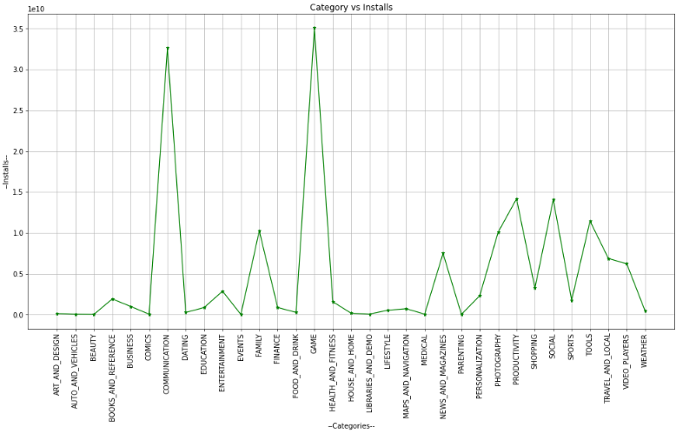
Top category installed application
We have Concluded from above chart there is highest number of app installed category is Game.

Slide 14
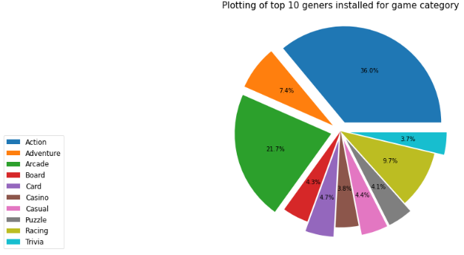
Top 10 Geners installed for Game category.
From pie chart analysis we are concluded Action And Adventure having more no of percentage as well as Trivia and Casio having lowest no percentage

Slide 15
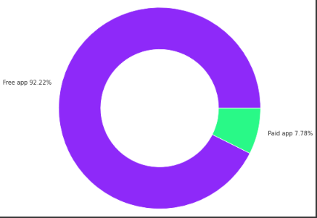
Paid apps Vs Free apps
From this analysis we can see 92.22% percentage of free app and 7.78% of paid app.
So we can say that most of apps on play store are free

Slide 16
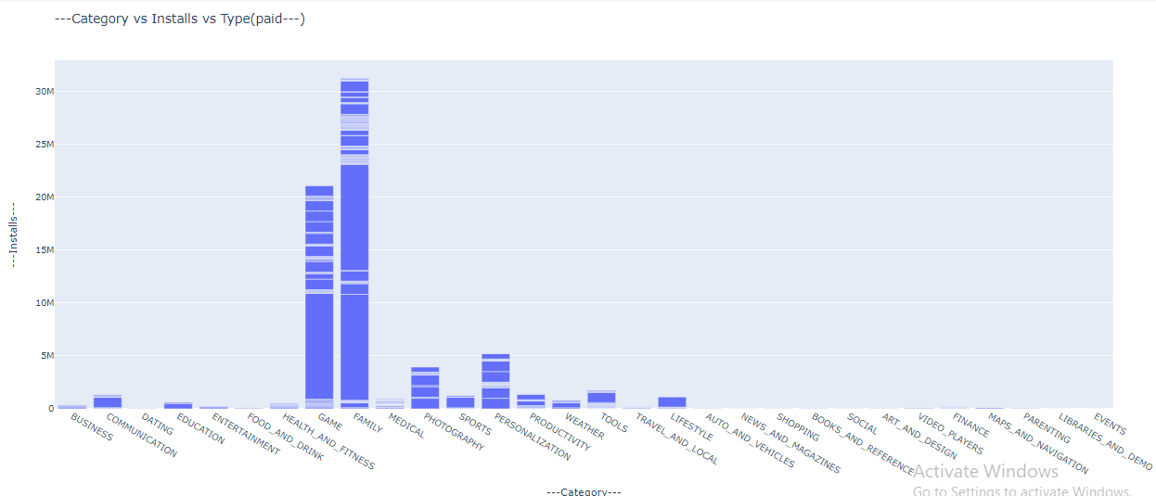
Plotting the bar plot of category Vs installs' Vs type (paid)
From above analysis we can see highest number of paid type category are family & Game

Slide 17
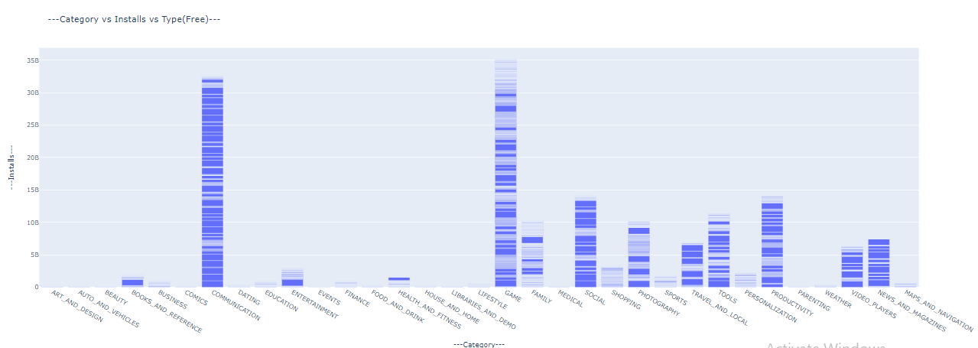
Plotting the bar plot category Vs installs Vs type(Free)
From above analysis we can see highest number of free type category are Game & communication

Slide 18
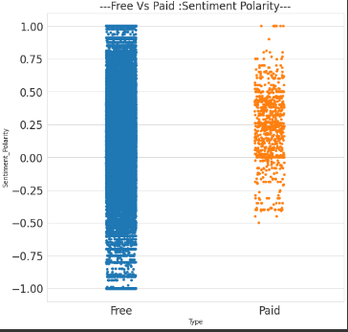
Plotting of Free Vs Paid polarity
From this Polarity graph clearly shows that Paid Apps are having less bad reviews and Free apps having a equal distribution of Sentiment Polarity.

Slide 19
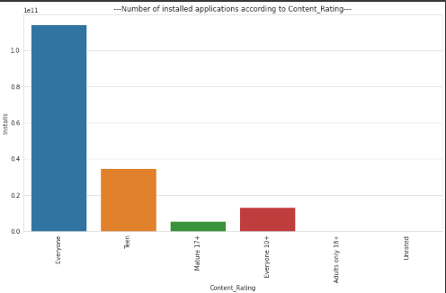
Find out which content rating have highest number of installed Application
From this plot we can see highest number of installed application Content Rating is everyone.

Slide 20
Conclusion:
Here we concluded as per pie chart it can be easily understood positive user review sentiments is 65%, negative user review sentiment is 22% and neutral user review sentiments is 11.399%
Every category is having more Positive reviews than Negative and Neutral reviews
Health and fitness having high no of positive reviews as compare others
Total highest no of review have Game category and lowest no of reviews have comics category
We have Concluded there is number of app available of family category but highest number of app installed category is Game
Action And Adventure having more no of percentage as well as Trivia and Casio having lowest no percentage
There are 92.22% percentage of free app and 7.78% of paid app available on google play store, So we can say that most of apps on play store are free
Highest number of paid type category are family & Game as well as highest number of free type category are Game & communication
Paid Apps are having less bad reviews and Free apps having a equal distribution of Sentiment Polarity
Highest number of installed application Content Rating is everyone

Slide 21
Thank You!
.

